Slide 1
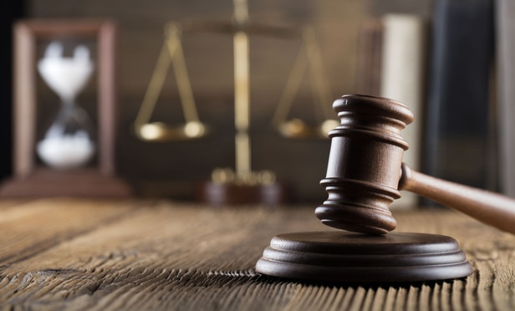
INTELLIGENT LEGAL
ADVISOR
Presented by:
Wajiha Javed
Kainaat Amjid
Warda Ahmed
Supervised by:
Dr. Wasi Haider

Slide 2

Outline
Problem
Motivation
Existing Systems
Objectives
Development Environment
Module Working
Front End Application
Future Work

Slide 3




Problem In Existing System
Time
consuming
Costly
Frequent
visits
Fraud
cases

Slide 4

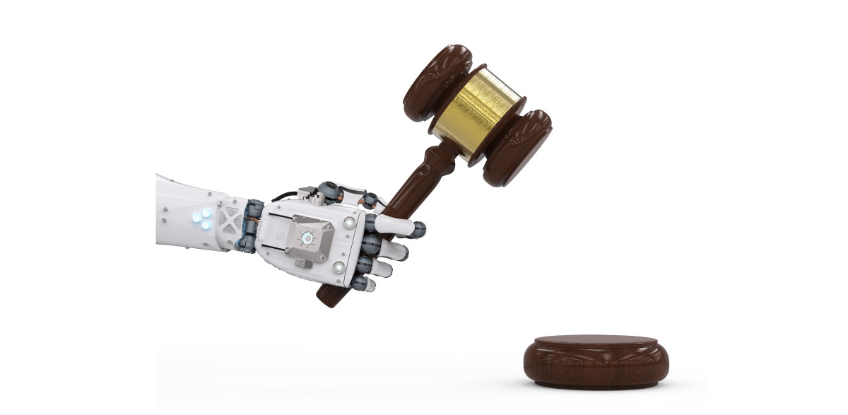
Motivation
Over 1.8 million pending cases
In high courts of Pakistan according
to Law & Justice Commission of Pakistan
( 21 Jan,2018)
Introducing Artificial Intelligence in Law and Justice domain
“Similar judgments for similar cases”

Slide 5


Existing System
Ensembles idea of LAWONLINE
Provides statutes, rules and cases related to Pakistan
Only accessible to lawyers or person registered after subscription payment
“Intelligent Legal Advisor introducing AI in law”

Slide 6





Existing System Internationally
Use artificial intelligence, including machine learning and natural language processing to extract data from contracts, bringing unprecedented accuracy and speed to analysis

Slide 7
Objectives
Predicting the Case Verdict on similar case similar judgment basis
Legal Document Summarization
Section Allotment to User’s Case Study
Similar Case Extraction

Slide 8

Development Environment
Backend Development
Coding Language: Python
Coding Environment: PyCharm IDE and command terminal
Packages used: NLP ,nltk, gensim, sklearn, docx,selenium

Slide 9

Frontend Development
Coding Environment: Atom IDE
Servers: Django , Flask
Databases: MySQL, JSON

Slide 10
Verdict Prediction
Step1
Step2
Classification
Dataset Preparation

Slide 11
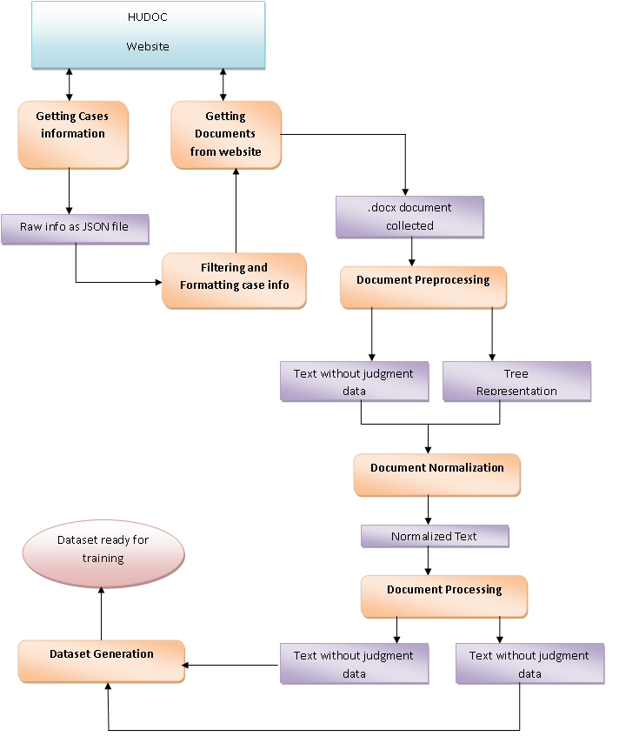
Dataset Preparation

Slide 12
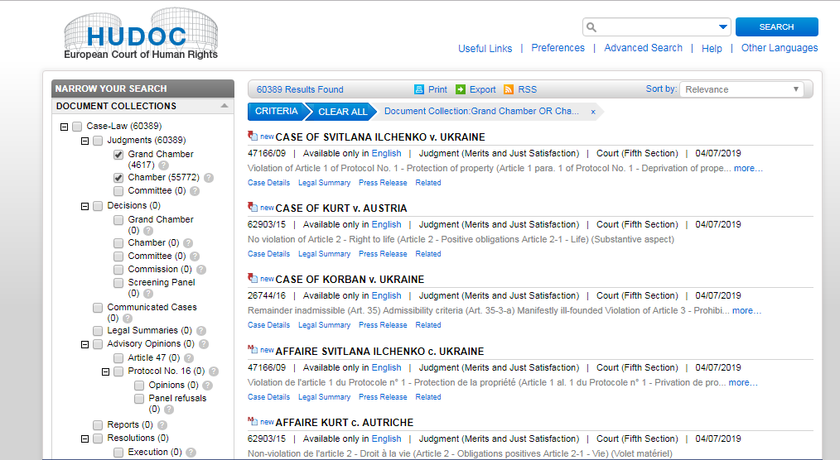
Retrieving Cases
Cases Documents are downloaded from
HUDOC European Court of Human Rights

Slide 13


Documents are downloaded in bulk automatically using python library “Selenium” with web driver plug-in of “Chrome”
Chrome extension of Batch Link Downloader

Slide 14
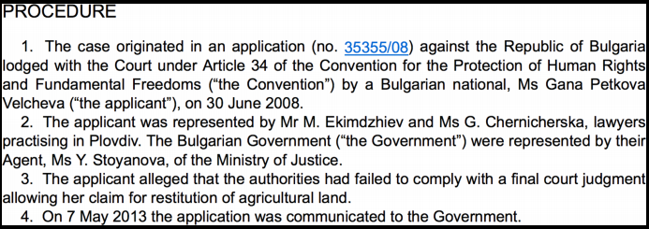
Cases Structure
Procedure followed before the Court

Slide 15
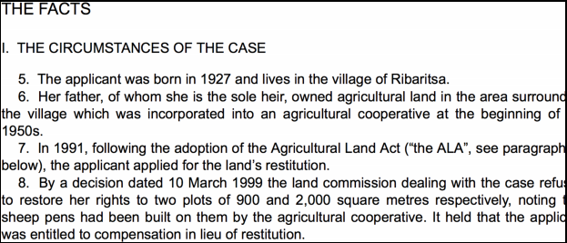
All material that is not considered as legal argument

Slide 16
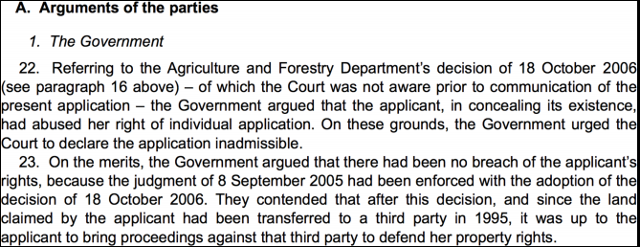
Merits of the case, through the use of legal argument

Slide 17
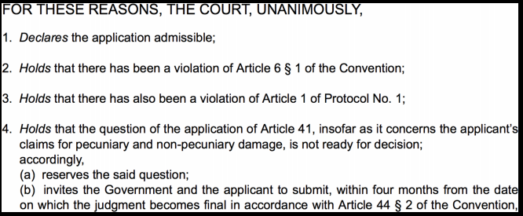
Outcome of the cases

Slide 18
Filtering Cases
Cases Documents from HUDOC European Court of Human Rights are in English and French, we only used English language documents
Documents with judgment are kept in database
Document with clear conclusion of violation and non violation of an article is kept.

Slide 19
Preprocessing Documents
Documents are processed to retrieve information
Documents are divided into two parts for creating test and train data
Set1
Set2
Documents after removing judgment part for testing
Documents with Judgment for training

Slide 20
Normalizing Documents
Documents are normalized by
Tokenization
Stop word removal
Part of Speech Lemmatization
Parsing the document n-grams are generated n € {1,2,3,4} i.e. uni-gram, bi-gram, tri-gram, four-gram

Slide 21
Processing Documents
Using “Gensim” library of python corpus of 5000 most common tokens based on normalization and n-grams is made to form Bag of Words (BOW) as features
<token_id>:<occurrence>
e.g. if bi-gram “find guilty” occurs 5 times in a document
128210:5

Slide 22
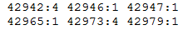
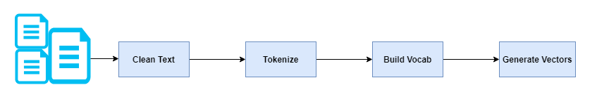
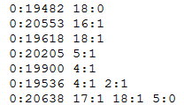
Dataset Generation
Collecting the BOW of all the documents and storing it in a file to be used as features
Labels are stored in a file “outcomes” 1:violation 0:non-violation

Slide 23
Classification
Dataset contains total documents : 8000
Train_data : Test_data: 80:20
k-folds : 10
Multilabel Dataset i.e. one document can have more than one outcome of violation or non violation
Classifier used: Decision Tree Classifier

Slide 24
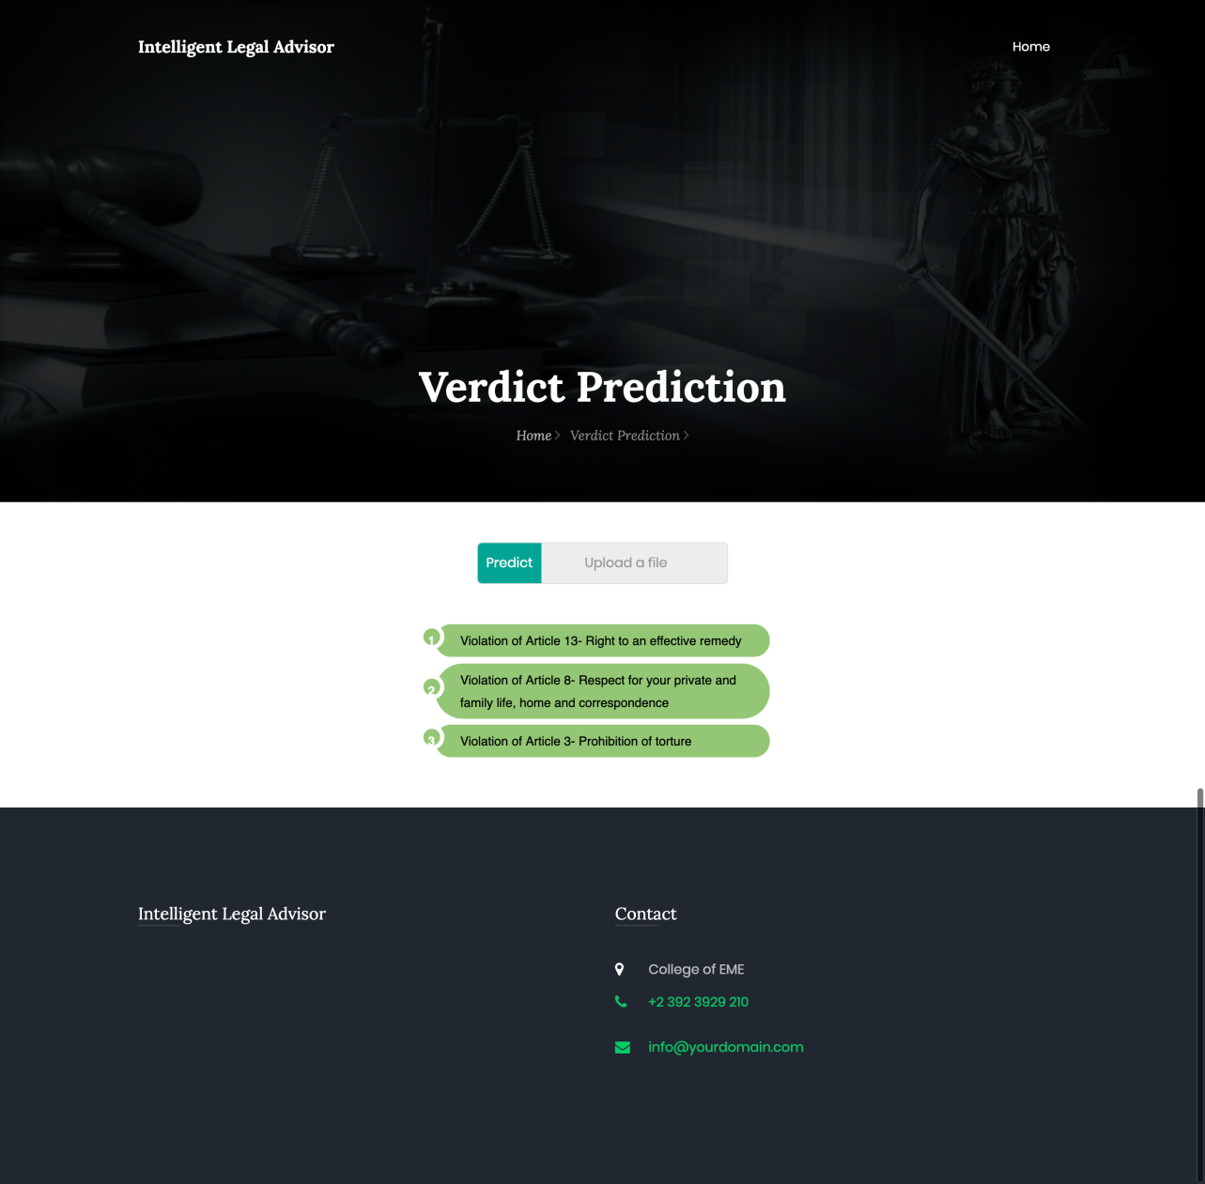
Working Interface

Slide 25
Classification Result:
Metrics | Results
Accuracy | 80.64%
Hamming Loss | 0.98%
Jaccard score | 87.61%
Recall | 86%
Precision | 88%
F1 score | 87%

Slide 26
Document Summarization
Method1
Method2
Abstractive Summary
Extractive Summary
“We implemented Method1: Extractive Summary”

Slide 27
Process
Pdf to Text file conversion
Tokenization of file content
Form Matrix of token to form vocabulary
Sorting in descending order from high to low rank
TF-IDF of vocabulary to generate corpus
PageRank algorithm to rank sentences
Joining sentences to form summary

Slide 28
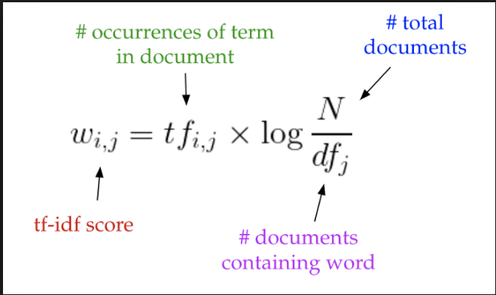
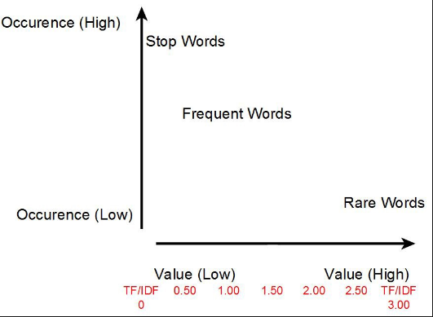
TF-IDF
Term Frequency- Inverse Document Frequency

Slide 29
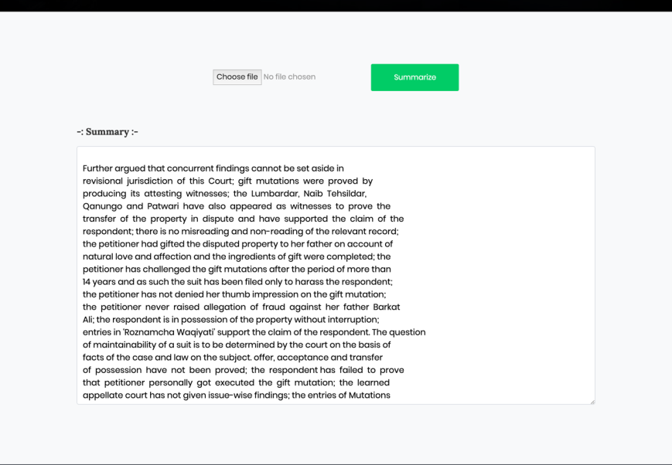
Working Interface

Slide 30
Section Allotment
Load Penal code from Db
Features Extraction
Pre processing of data
Calculate cosine similarity of query with all penal codes
Training of data
Input query
Section with highest similarity is assigned

Slide 31
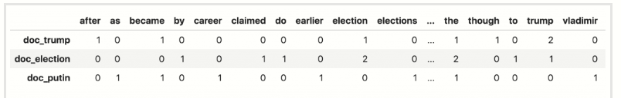
Cosine Similarity
Common words count
Matrix

Slide 32
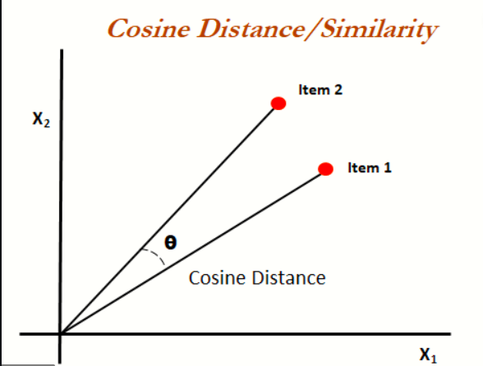
Cosine Similarity
Similarity matrix
Extract most similar

Slide 33
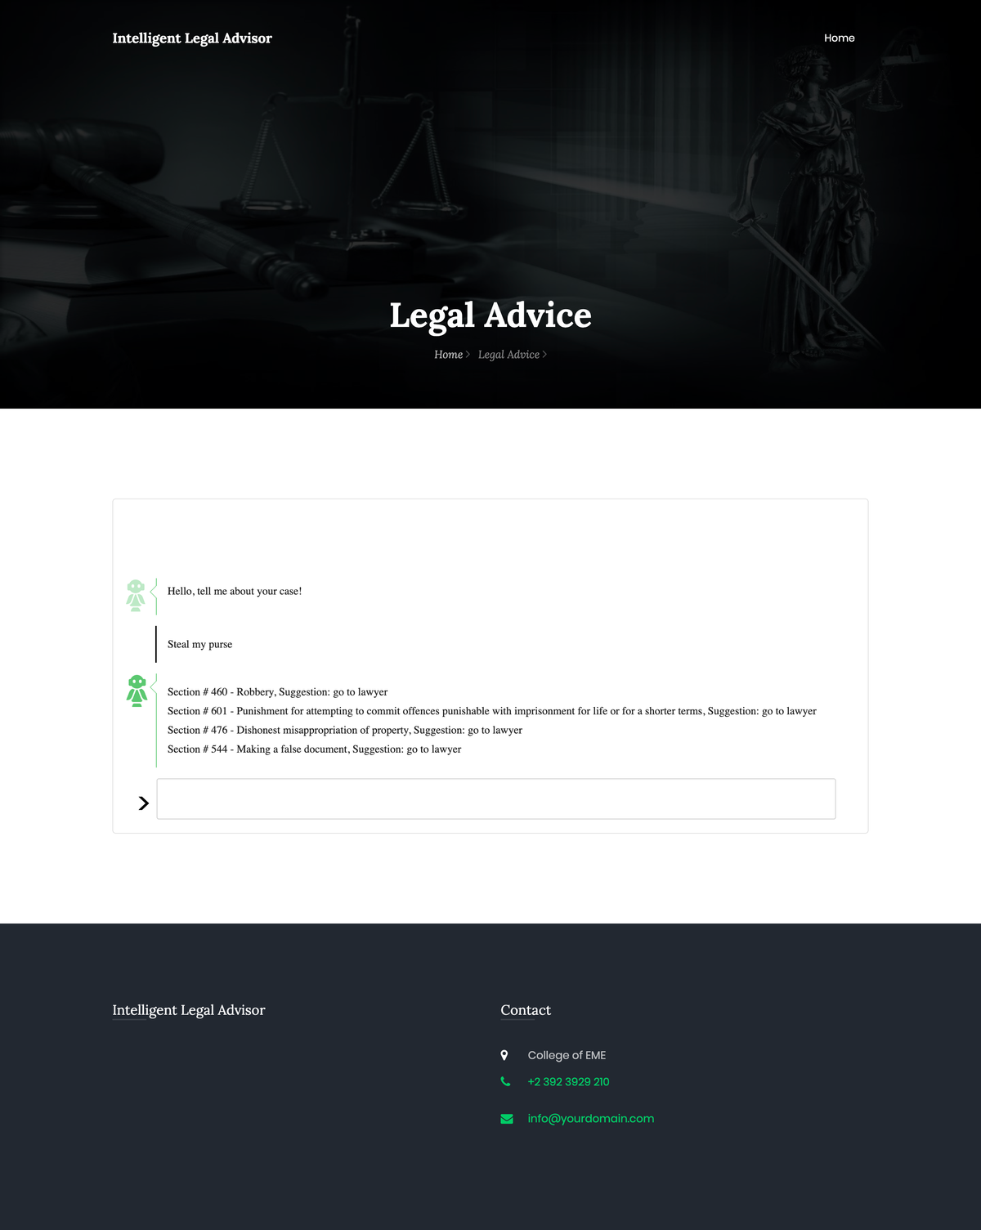
Working Interface

Slide 34
Other Method done but didn’t worked
Worked on algorithm but not used due to lack of data
Euclidian distance (contextual)
Jaccard
Common word(more cw, more similarity)
N-grams
tfidf,idf(long sentences)

Slide 35
Word2vec
Text to numbers
word embedding
Close meaning
Cbow skipgram

Slide 36
Doc2vec
numeric representation of a document
vector Paragraph ID
word vectors ->concept of a word
document vector->concept of a document.

Slide 37
Similar Document Extractor
Data in Db as text files
Label extraction and Corpus generation
Train using Doc2Vec
Cosine similarity between documents
Model saved after training
Testing of documents from trained data
Extract document with corresponding similarity

Slide 38
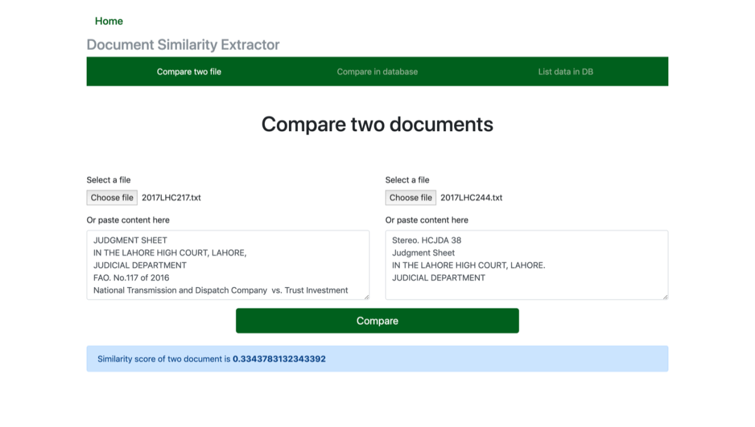
Working Interface

Slide 39
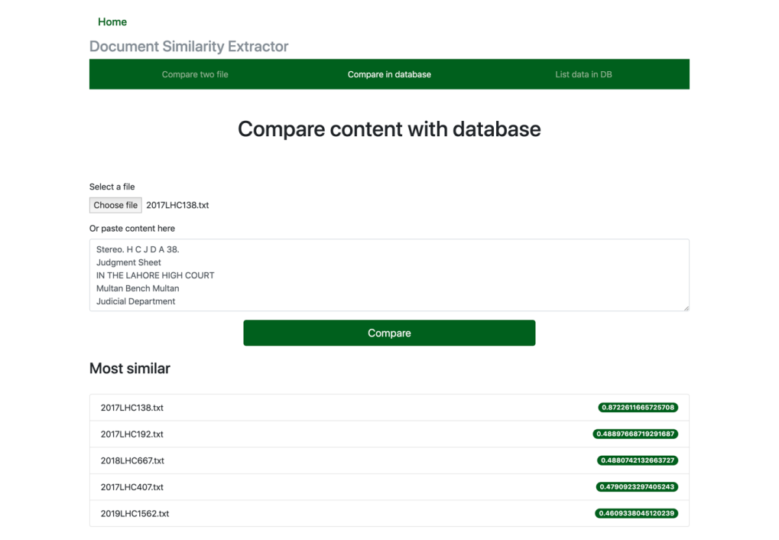
Working Interface

Slide 40
Front End Application
3 servers - Django, Flask, mySQL
Five modules (Verdict prediction, Section allotment, Summarization, Doc Similarity, Lawyer recommender)
Django Web Framework: HTML + CSS design with URL mapping for all 5 modules, added JS functionality
Integration with backend data and algorithms

Slide 41
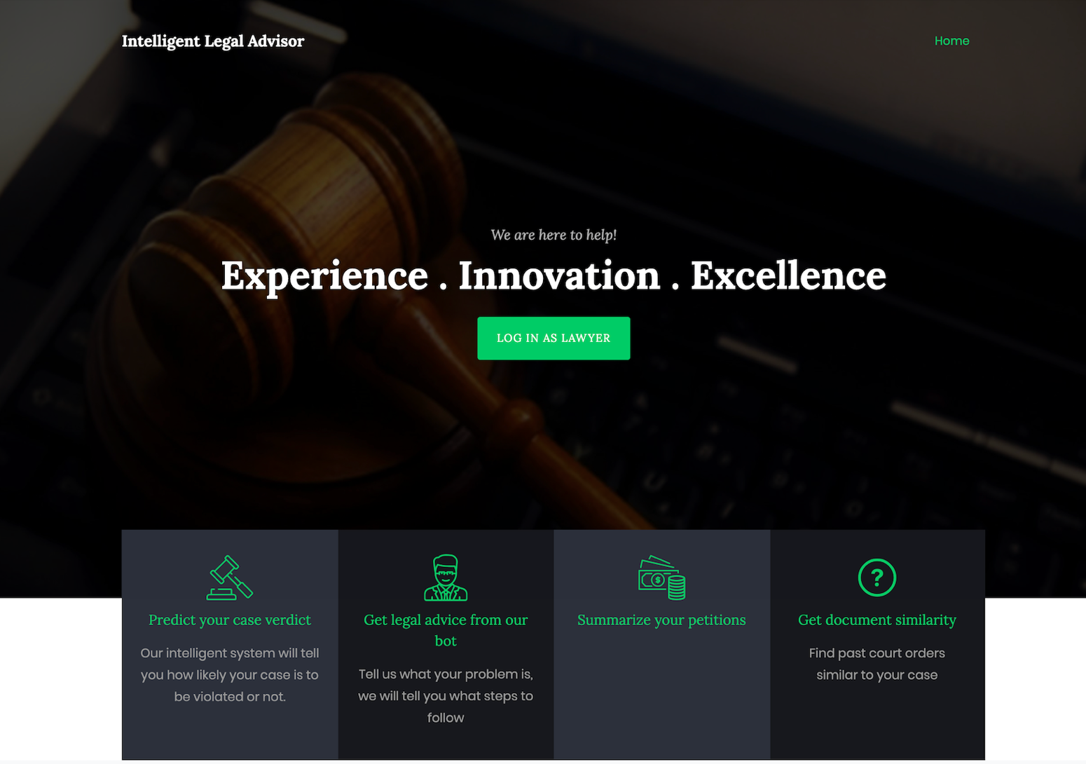

Slide 42
Lawyer Recommendation Module
Excel csv data -> mySQL database
Connect database to Django web application
Load results from database filtered SQL queries according to user’s selected city and category

Slide 43
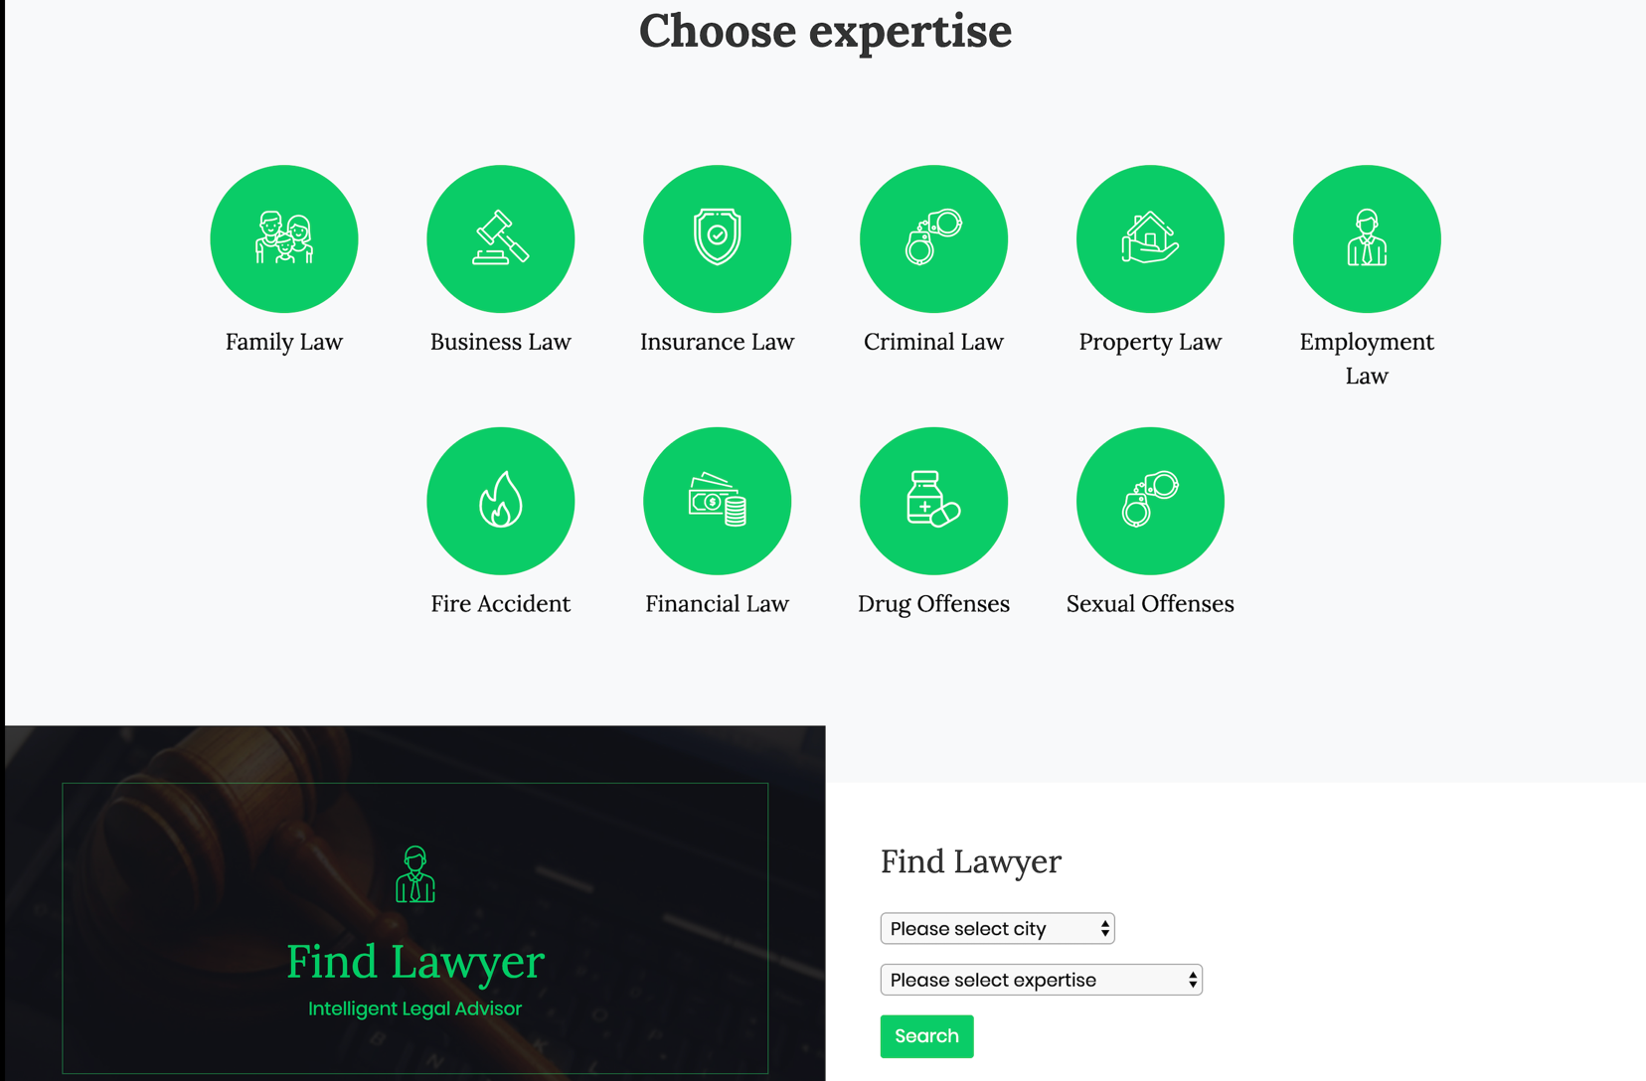

Slide 44
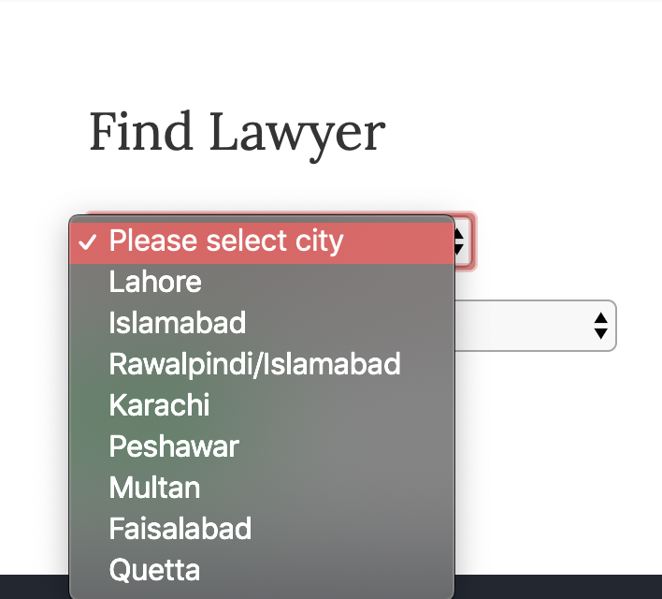
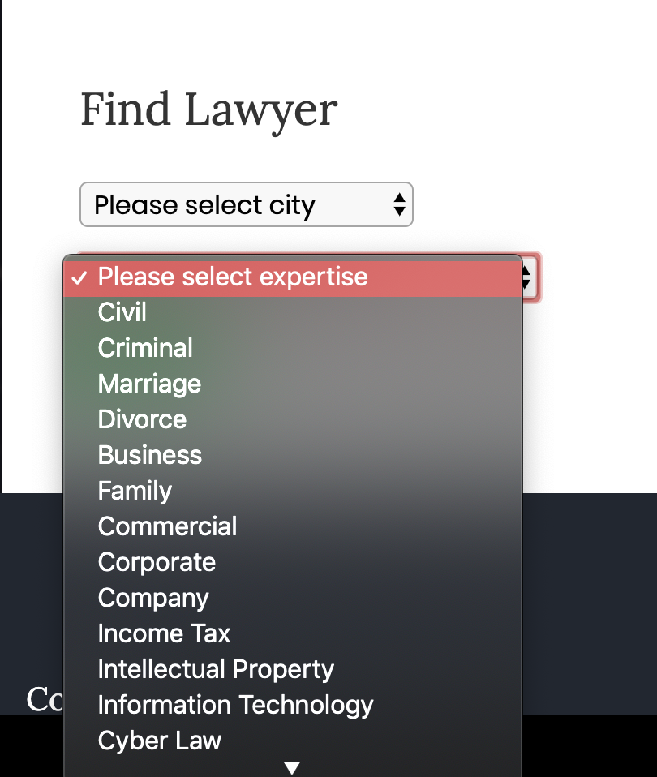

Slide 45
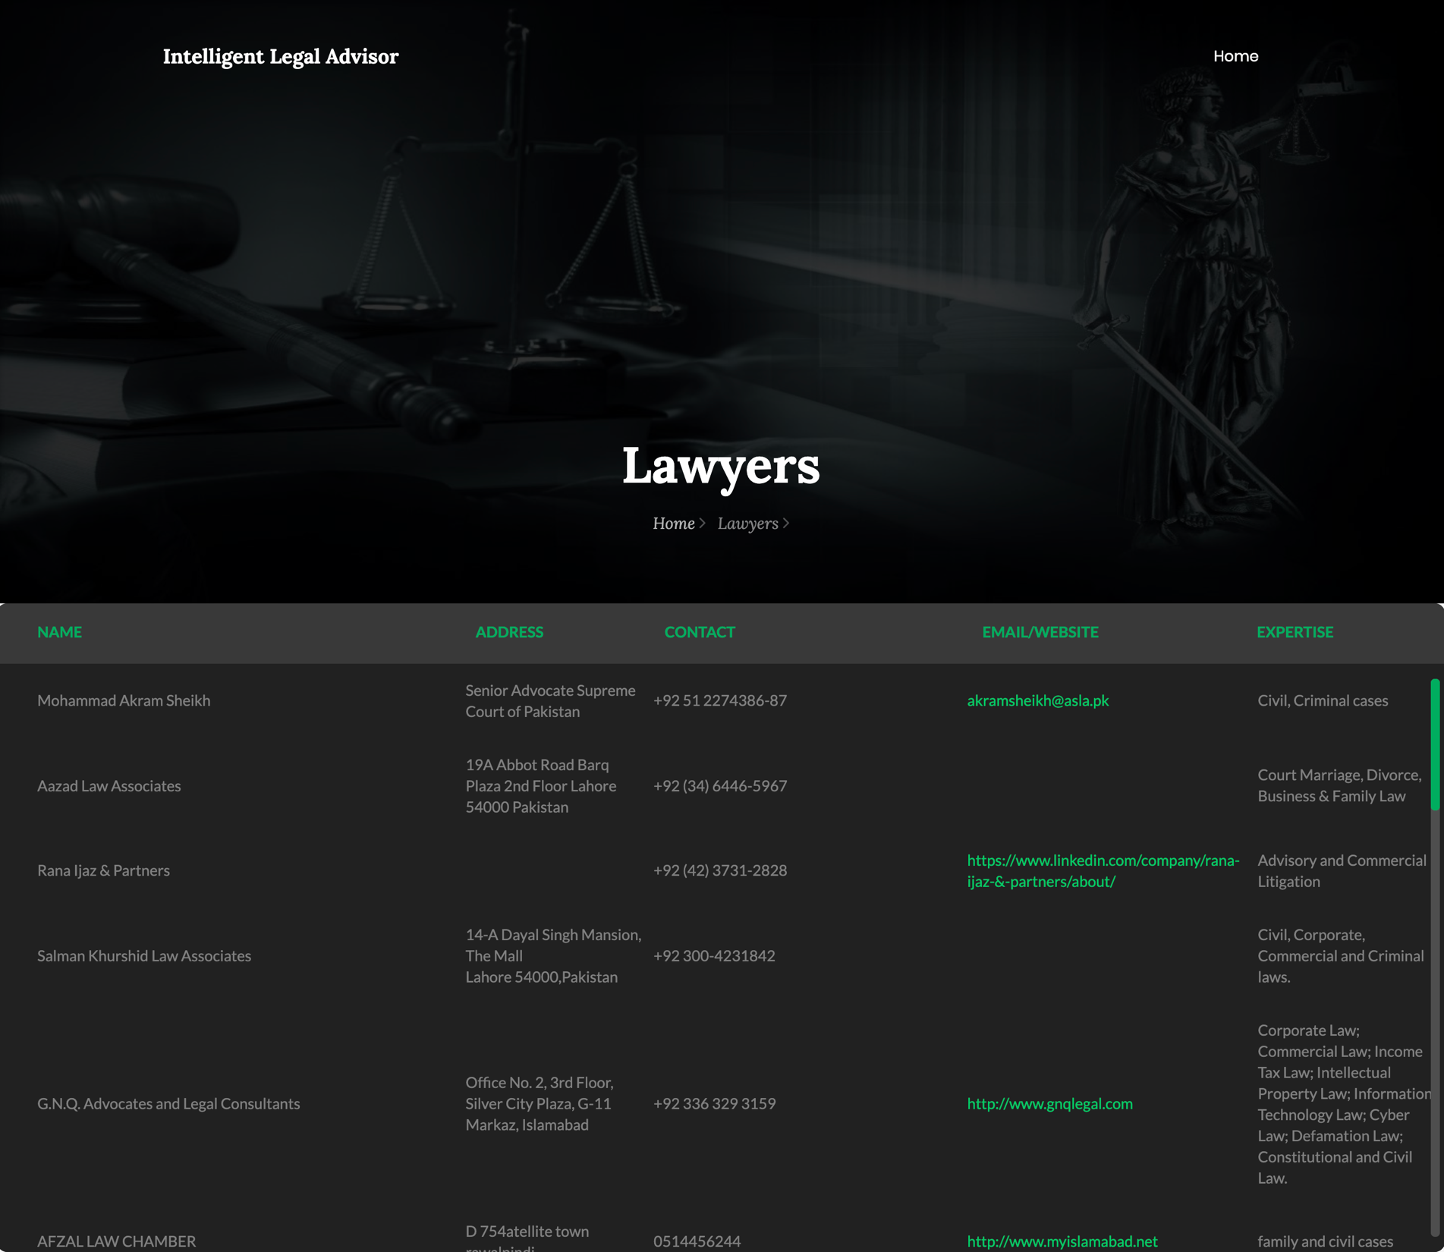

Slide 46
Future Work
Accuracy can be increased by making algorithm more efficient by using tool LexNLP
Converted for Pakistan court judgments after labeling .( Chief Justice of Pakistan wants to initiate a project that can do verdict predication)

Slide 47


